Slide 1

Vue 3.0 Updates
Evan You
VueConf TO, Nov. 2018

Slide 2
What’s coming in Vue 3.0
Make it faster
Make it smaller
Make it more maintainable
Make it easier to target native
Make your life easier

Slide 3
Make it faster

Slide 4
Virtual DOM implementation re-written from the ground up
Up to 100% faster mounting & patching

Slide 5
More compile-time hints
to reduce runtime overhead

Slide 6
Component fast path + Monomorphic calls + Children type detection
Template
Compiler output
render() {
const Comp = resolveComponent('Comp', this)
return createFragment([
createComponentVNode(Comp, null, null, 0 /* no children */),
createElementVNode('div', null, [
createElementVNode('span', null, null, 0 /* no children */)
], 2 /* single vnode child */)
], 8 /* multiple non-keyed children */)
}
<Comp></Comp>
<div>
<span></span>
</div>
Skip unnecessary condition branches
Easier for JavaScript engine to optimize

Slide 7
Optimized Slots Generation
Template
Compiler output
render() {
return h(Comp, null, {
default: () => [h('div', this.hello)]
}, 16 /* compiler generated slots */)
}
<Comp>
<div>{{ hello }}</div>
</Comp>
Ensure dependencies are tracked by correct instance
Avoid unnecessary parent / children re-renders

Slide 8
Static Tree Hoisting
Template
Compiler output
const __static1 = h('span', {
class: 'foo'
}, 'static')
render() {
return h('div', [
__static1,
h('span', this.dynamic)
])
}
<div>
<span class="foo">
Static
</span>
<span>
{{ dynamic }}
</span>
</div>
Skip patching entire trees
Works even with multiple occurrences

Slide 9
Static Props Hoisting
Template
Compiler output
const __props1 = {
id: 'foo',
class: 'bar'
}
render() {
return h('div', __props1, this.text)
}
<div id="foo" class="bar">
{{ text }}
</div>
Skip patching the node itself, but keep patching children

Slide 10
Inline Handler Hoisting
Template
Compiler output
<Comp @event="count++"/>
import { getBoundMethod } from 'vue'
function __fn1 () {
this.count++
}
render() {
return h(Comp, {
onEvent: getBoundMethod(__fn1, this)
})
}
Avoid unnecessary re-renders due to different inline function identity

Slide 11
Proxy-based observation mechanism with full language coverage + better perf
Property addition / deletion
Array index / length mutation
Map, Set, WeakMap, WeakSet
Classes

Slide 12
Faster instance property proxying using native Proxy
Bye Object.defineProperty!

Slide 13
Up to 100% faster
Component instance initialization

Slide 14
Double the speed
Half the memory usage

Slide 15
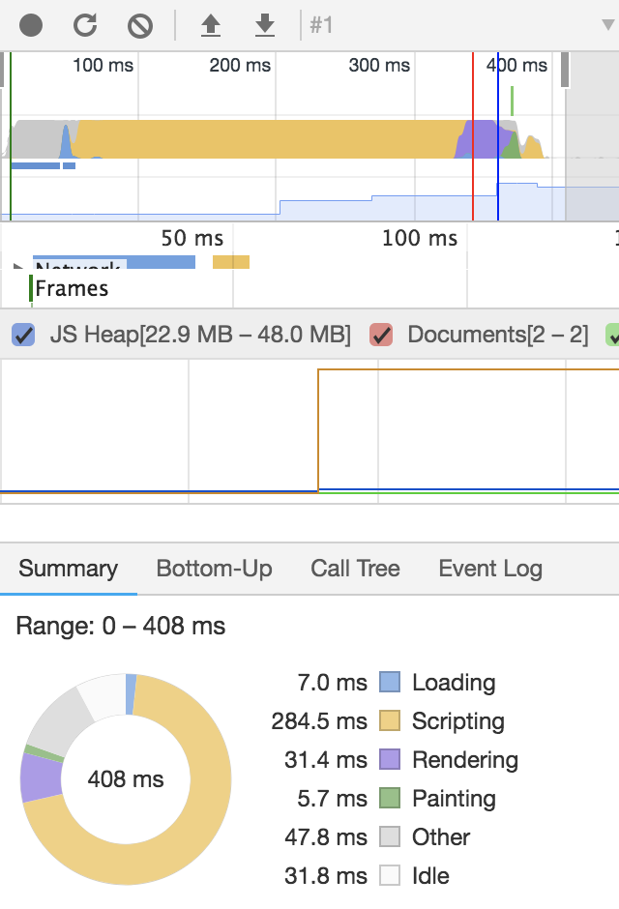
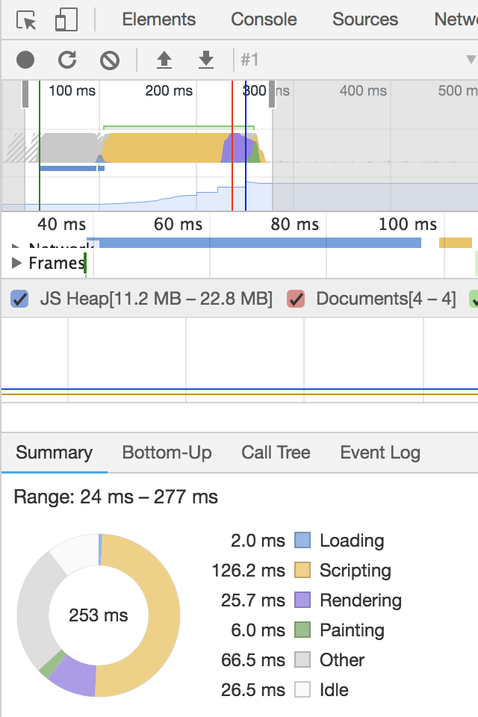
v2.5
v3.0-proto
Rendering 3000 stateful component instances
Notes:
Double the speed across the board. Reduces memory usage by half

Slide 16
Make it smaller

Slide 17
Tree-shaking Friendly
Built-in components (keep-alive, transition…)
Template directive runtime helpers (v-model, v-for…)
Utility functions (asyncComponent, mixins, memoize...)

Slide 18
New core runtime: ~10kb gzipped

Slide 19
Make it more maintainable

Slide 20
Flow -> TypeScript

Slide 21
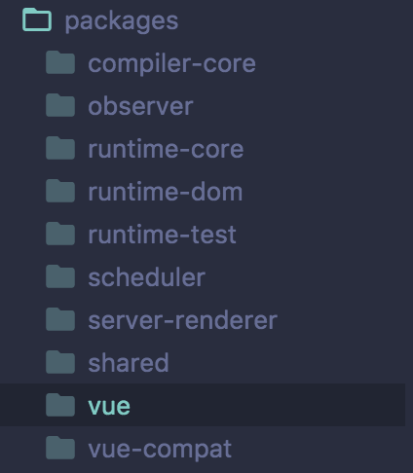
Decoupled Packages

Slide 22
Compiler Rewrite
Pluggable architecture
Parser w/ location info (source maps!)
Serve as infrastructure for more robust IDE support

Slide 23
Make it easier to target native

Slide 24
Custom Renderer API
import { createRenderer } from '@vue/runtime-core'
const { render } = createRenderer({
nodeOps,
patchData
})

Slide 25
Make your life easier

Slide 26
Exposed reactivity API
import { observable, effect } from 'vue'
const state = observable({
count: 0
})
effect(() => {
console.log(`count is: ${state.count}`)
}) // count is: 0
state.count++ // count is: 1

Slide 27
Easily identify
why a component is re-rendering
const Comp = {
render(props) {
return h('div', props.count)
},
renderTriggered(event) {
debugger
}
}
Demo

Slide 28
Improved TypeScript Support w/ TSX
interface HelloProps {
text: string
}
class Hello extends Component<HelloProps> {
count = 0
render() {
return <div>
{this.count}
{this.$props.text}
</div>
}
}
Demo

Slide 29
Better warning traces
Now includes functional components
Inspectable props
Traces are available in more warning cases
Demo

Slide 30
Experimental Hooks API
Demo

Slide 31
Experimental
Time Slicing Support
Demo

Slide 32
But how about IE?
TL;DR: IE11 will be supported

Slide 33
Thank you!

